Slide 1

presenter → 刘美含
ppt maker → 王灵玥、友人A
American part → 刘美含
Korean part → 朱蓉、李梦婷
Chinese part → 汤蓓、陈薇

Slide 2

ABOUT DRAMAS
by our team
2016.5.XX.

Slide 3
American
passion
newness
love.

Slide 4


Slide 5


Slide 6


Slide 7
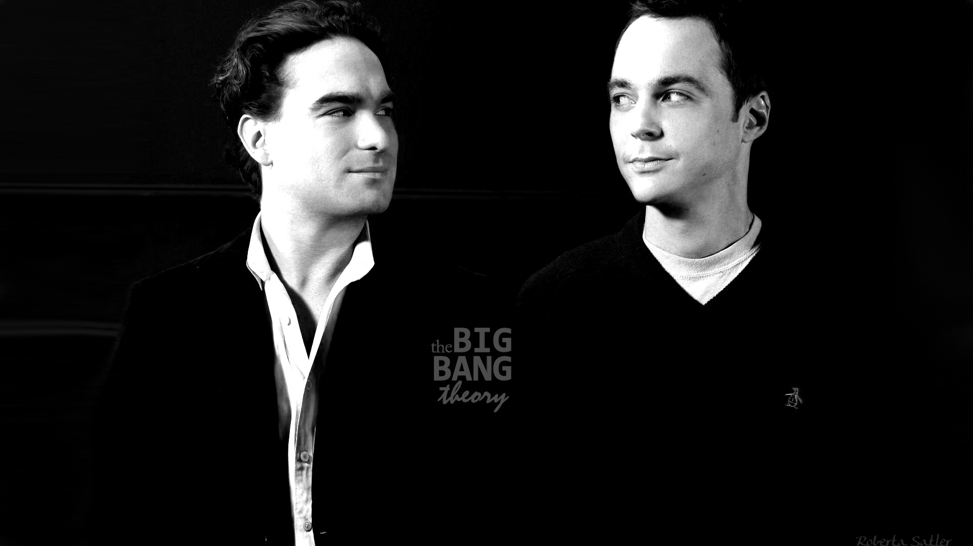

Slide 8
KINDS
LOVE
FRIENDSHIP
FAMILY

Slide 9

Edward
Bella
with

Slide 10


Slide 11


Slide 12



Newness.
Passion.
Love.

Slide 13
Korea
love story

Slide 14
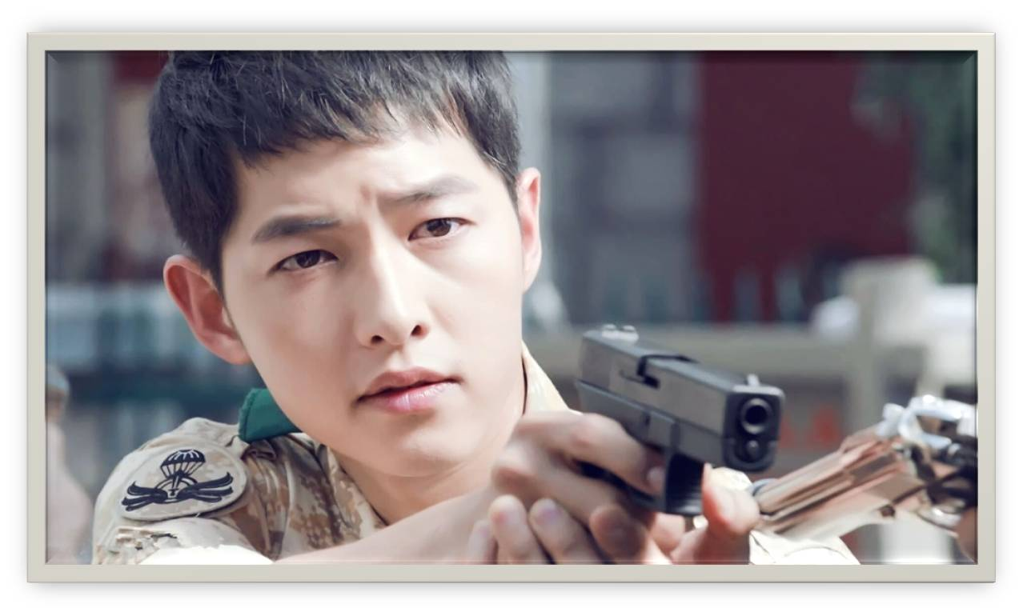
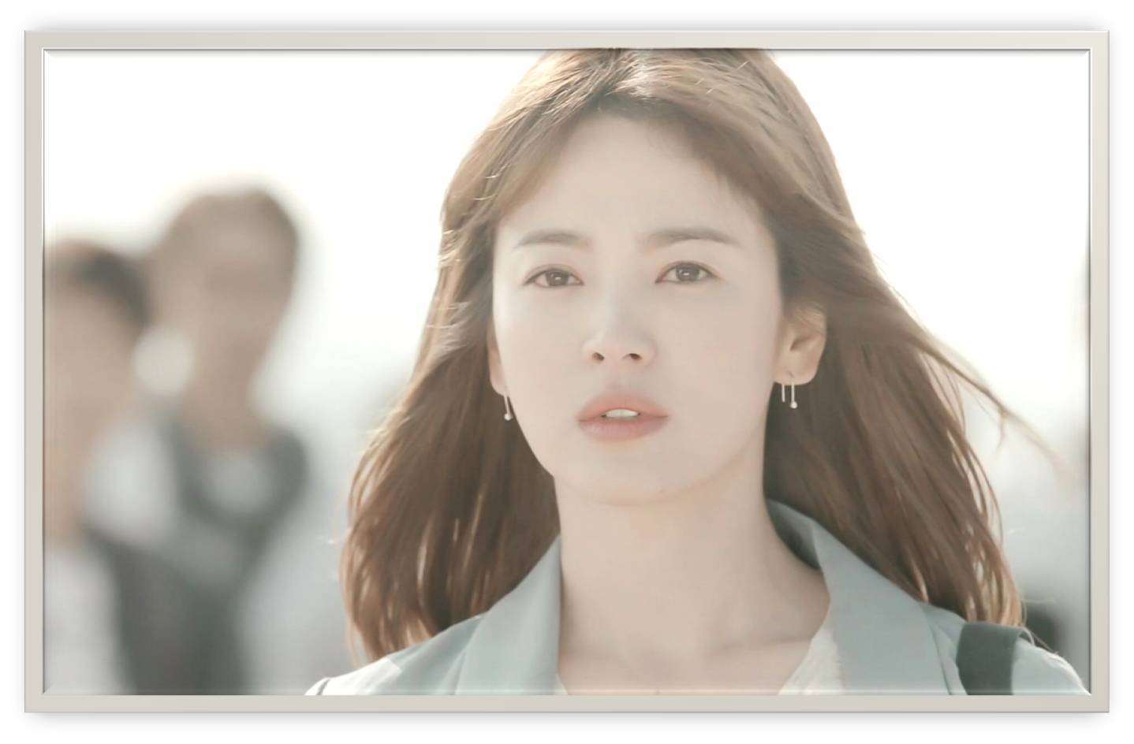
attractive appearance

Slide 15


Slide 16

Never
let me go

Slide 17
Mainland
promising future

Slide 18

Nirvana
in
Fire

Slide 19

Zhen Huan Preach

Slide 20

Battle of Changsha

Slide 21



Slide 22
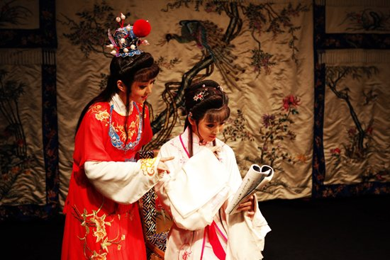


Slide 23


Slide 24


Slide 25


Slide 26

BRIGHT FUTURE

Slide 27
INTERNATIONAL
American
Korea
Mainland
No matter what style of TV each country made, is want to give the audience to enlightenment.
↓
Each has his own merits

Slide 28
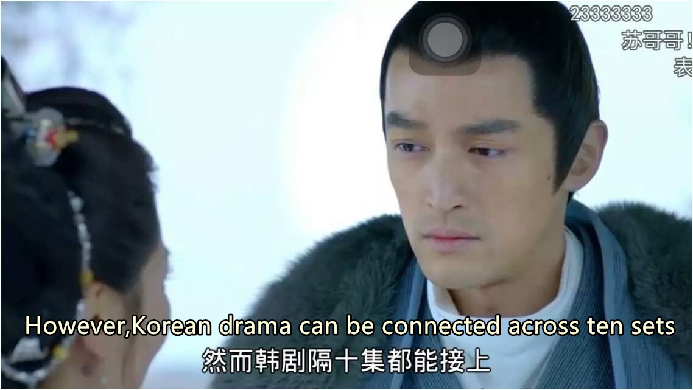
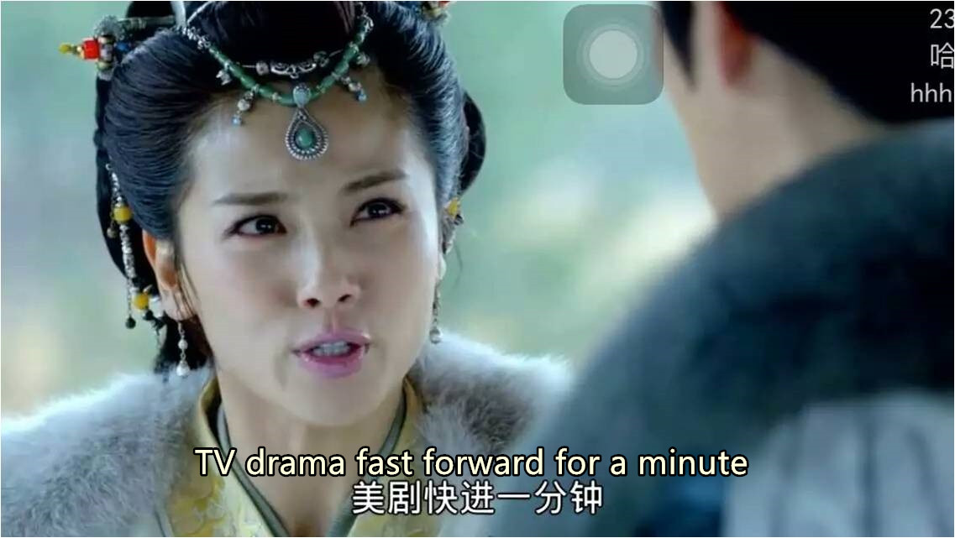
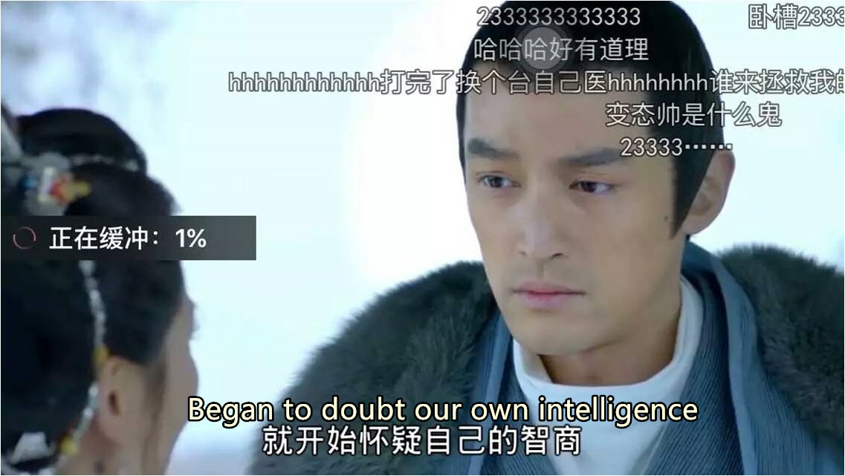
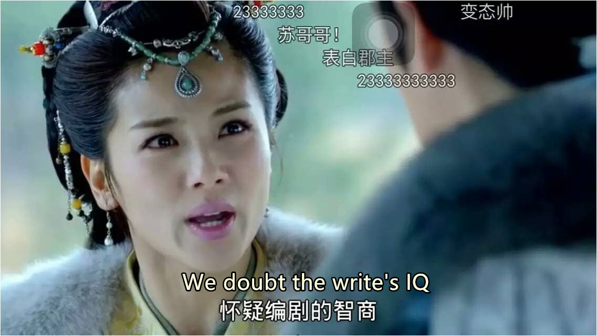
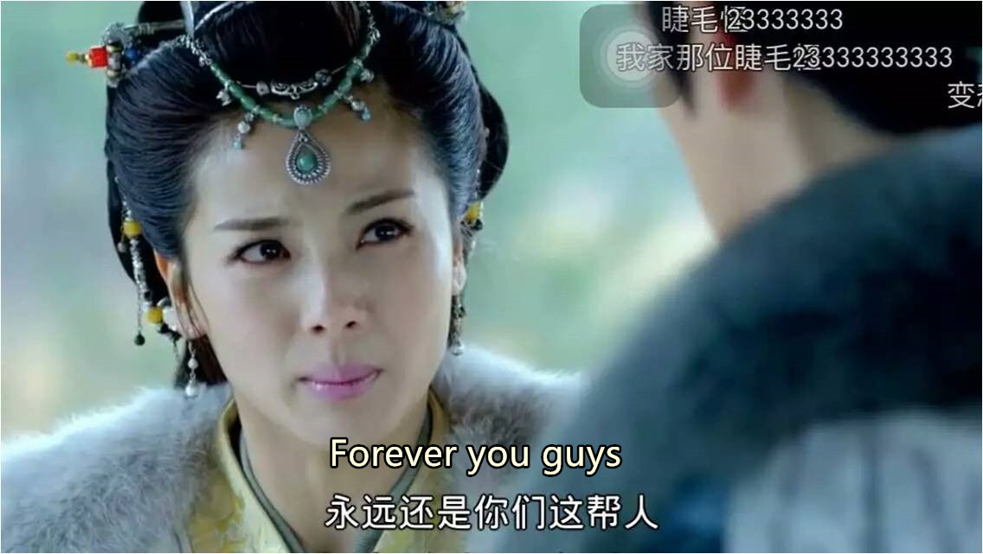
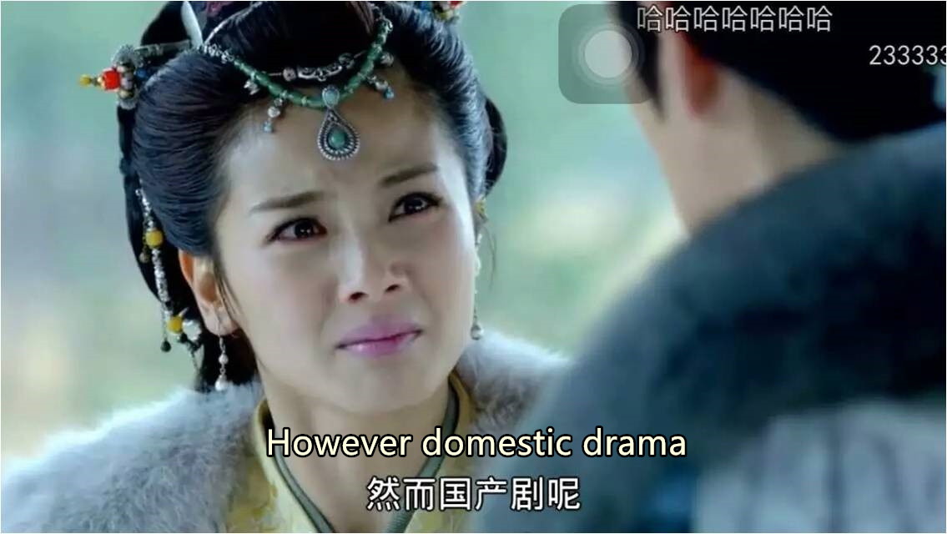
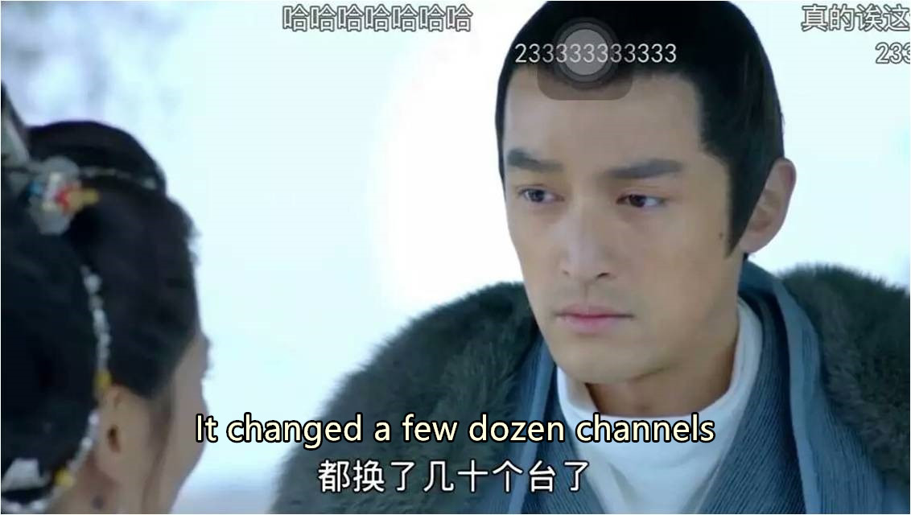

Slide 29


THE
END
THANKS FOR YOUR LISTENING!

